Slide 1

BU Spark! Athletics

Slide 2
Key Tasks to Complete
Complete Base Question 4-6
Preprocess
Analysis
Visualization
Interpretation
Data Documentation
Upload data & code (Q4-6) with proper documentation

Slide 3
PROCESS
Complete Base Question 4-6
Preprocess
Analysis
Visualization
Interpretation
Data Documentation
Upload data & code (Q4-6) with proper documentation

Slide 4
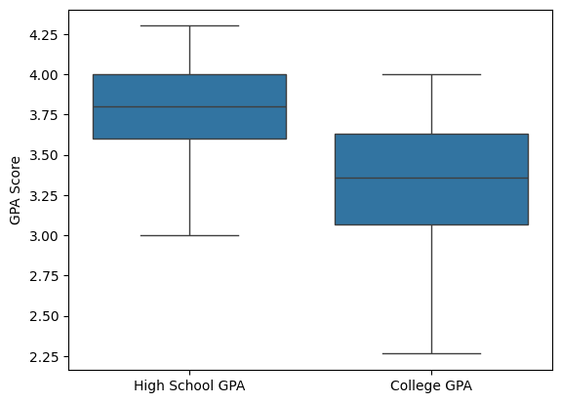
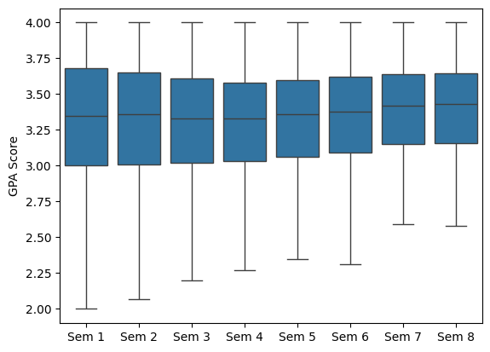
Key Output - Q4

Slide 5
Lower Quartile GPA
Lowest GPA
Semester 1: 3.00
Semester 2: 3.01
Semester 3: 3.02
Semester 4: 3.03
Semester 5: 3.06
Semester 6: 3.09
Semester 7: 3.15
Semester 8: 3.16
Semester 1: 1.10
Semester 2: 1.57
Semester 3: 1.86
Semester 4: 2.16
Semester 5: 2.35
Semester 6: 2.31
Semester 7: 2.30
Semester 8: 2.29

Slide 6
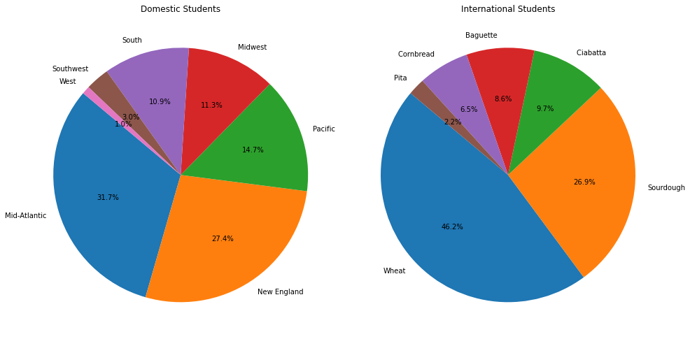
Key Output - Q5
Domestic
Mid-Atlantic (31.7%)
New England (27.4%)
Pacific (14.7%)
International
Wheat (46.2%)
Sourdough (26.9%)
Ciabatta (9.7%)
Notes:
Do students from certain geographic areas (Northeast) perform better academically than another geographic area (Southwest)?
how students are distributed geographically
domestic: mid-atlantic, new england, pacific
international: wheat, sourdough, ciabatta
Number of Domestic Students: 526
Number of International Students: 97

Slide 7
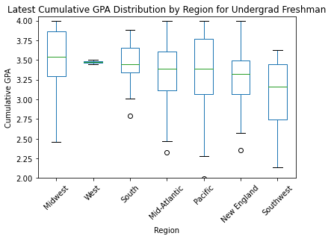
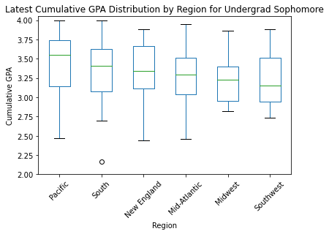
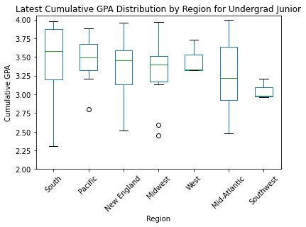
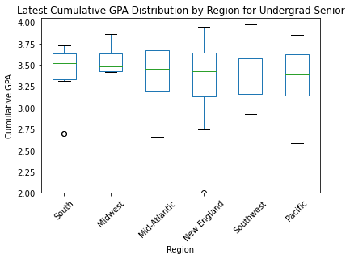
Students from South regions generally perform better academically
The Pacific area also shows strong performance in Sophomore and Junior year
The Southwest region tends to have the lowest median GPA
Notes:
Students from the Midwest and South regions generally perform better academically, with consistently high median GPAs across years. The Pacific also shows strong performance. In contrast, the Southwest region tends to have the lowest median GPAs, suggesting a potential need for academic support.
Midwest: best in freshman year
South: best in Junior and senior year, but also shows great variability in junior year
Pacific: also shows astonishing performance in sophomore, generally shows greater variability in freshman, sophomore
Southwest: generally performs worse, consistently the lowest in median
Mid-Atlantic, South: great variability (especially south for junior year)
Junior year: high variability (with outliers)

Slide 8
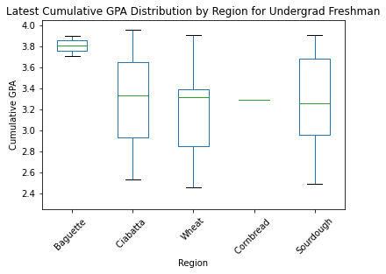
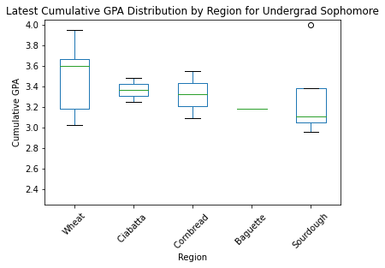
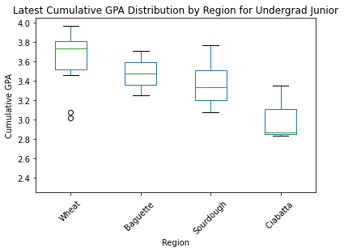
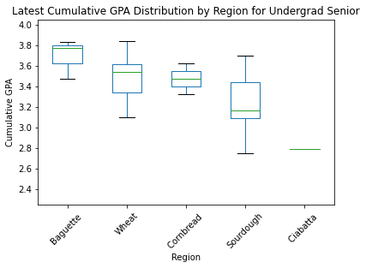
Students from Baguette and Wheat regions generally perform better academically
The Ciabatta region shows strong performance in Freshman and Sophomore year, but turns into region with lowest median GPAs in Junior and Senior year
Notes:
International students from the Baguette and Wheat regions appear to perform better academically, with high median GPAs and consistent performance across years.
In contrast, students from Ciabatta show strong performance in first two years, but drop to region with the lowest median GPAs in the last two year, suggesting that they may need additional academic support for Junior and Senior year.
Cornbread and Sourdough regions show moderate performance, students from these regions are achieving respectably but not as high as those from Baguette and Wheat.
Look at individual region
Wheat: the median line tend to be left-skewed, lower values are more spread out
Pita: incomplete data, difficult to analyze
Cornbread: consistent moderate performance
Sourdough: worse than cornbread, relatively lower performance, median line right-skewed, higher values are more spread out, more data concentrated at lower values, especially sophomore year, outliers on top (exceptional high performers)

Slide 9
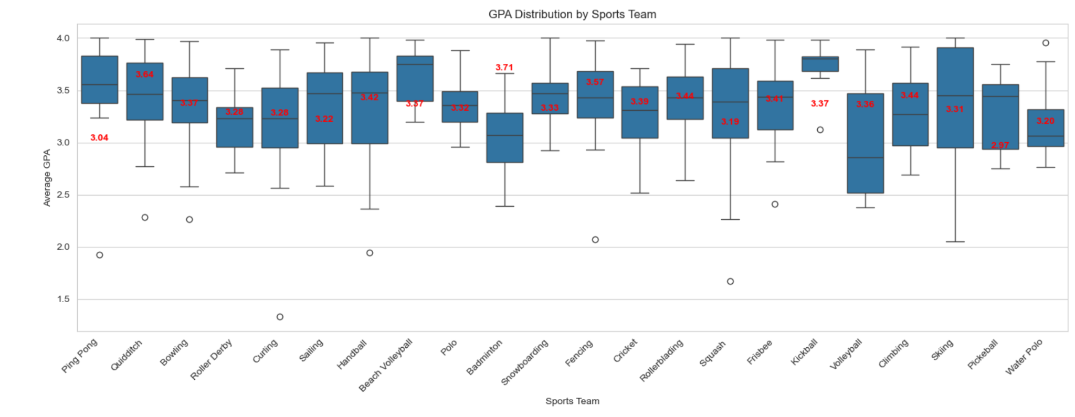
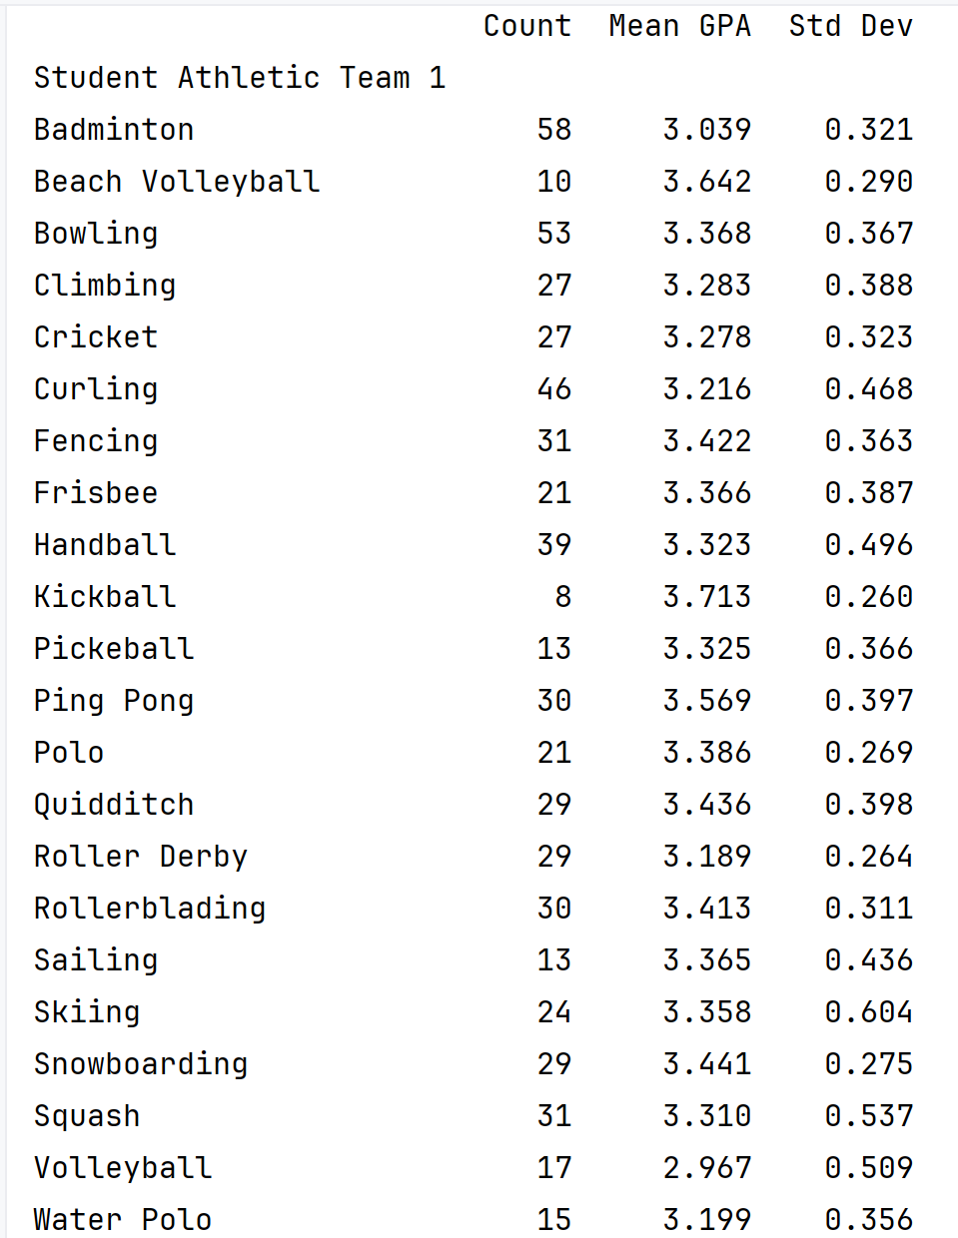
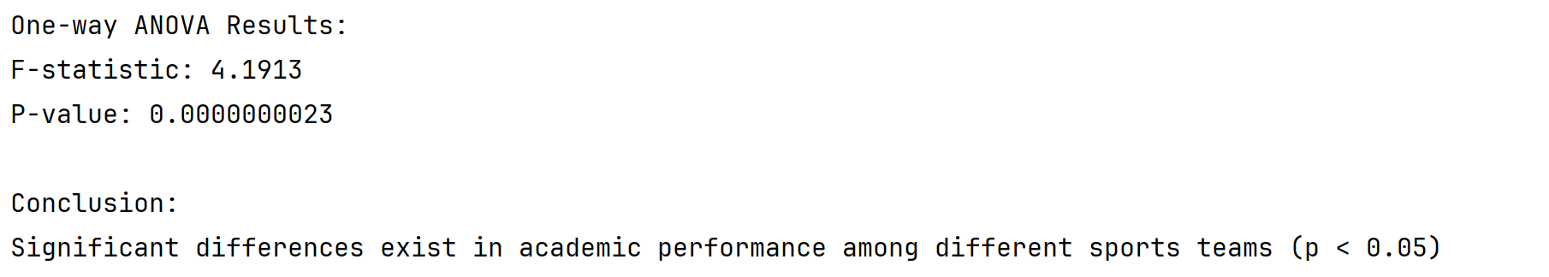
Key Output - Q6
Q6: Are there any significant differences in the academic performance of student-athletes based on their sport?
one-way ANOVA

Slide 10
Blockers
Based on the current analysis, is there any other area you would like us to explore more?
Lack of data especially for international students

Slide 11
Future steps
Next Meeting Time: Nov. 22
Explore & Add all the missing points mentioned in today’s meeting
Upload Modified Data & Code with proper documentation
Preparation for prediction model
Brainstorm strategies
Preparation for final report and presentation

Slide 12

Thank you!

